Slide 1
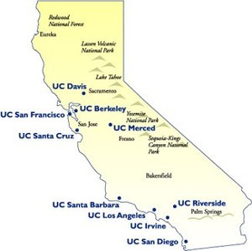

Predicting the student yield for the University of California
Michal, Nick, Nelson

Slide 2

Outline
Main goal
Our Dataset
Data Cleaning
Exploration/Visualization
Plans for next iteration

Slide 3
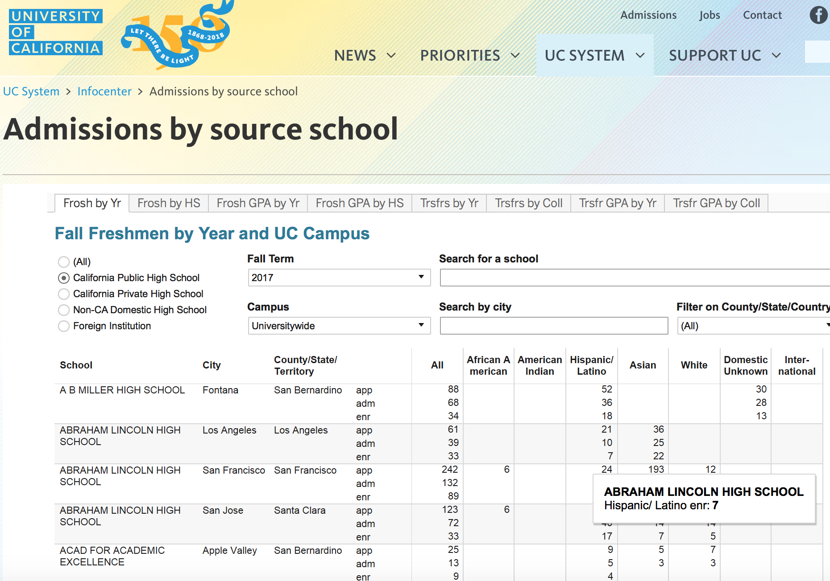
Main Goal
Determine the yield for each college given information about the admitted class
Admission data is legally protected
Only highly anonymized data sets are publicly available
Data comes from the University of California infocenter
https://www.universityofcalifornia.edu/infocenter/admissions-source-school

Slide 4

Our Dataset
Number of applying, admitted and enrolled students from each high school
Average GPA for applying, admitted and enrolled students at each high school
Demographic data (students' race/ethnicity)
Locations of the high schools by city (if within US, otherwise NaN), county (if within CA, otherwise NaN), and region (state if within US, otherwise country)
Data is sorted by year and UC campus

Slide 5
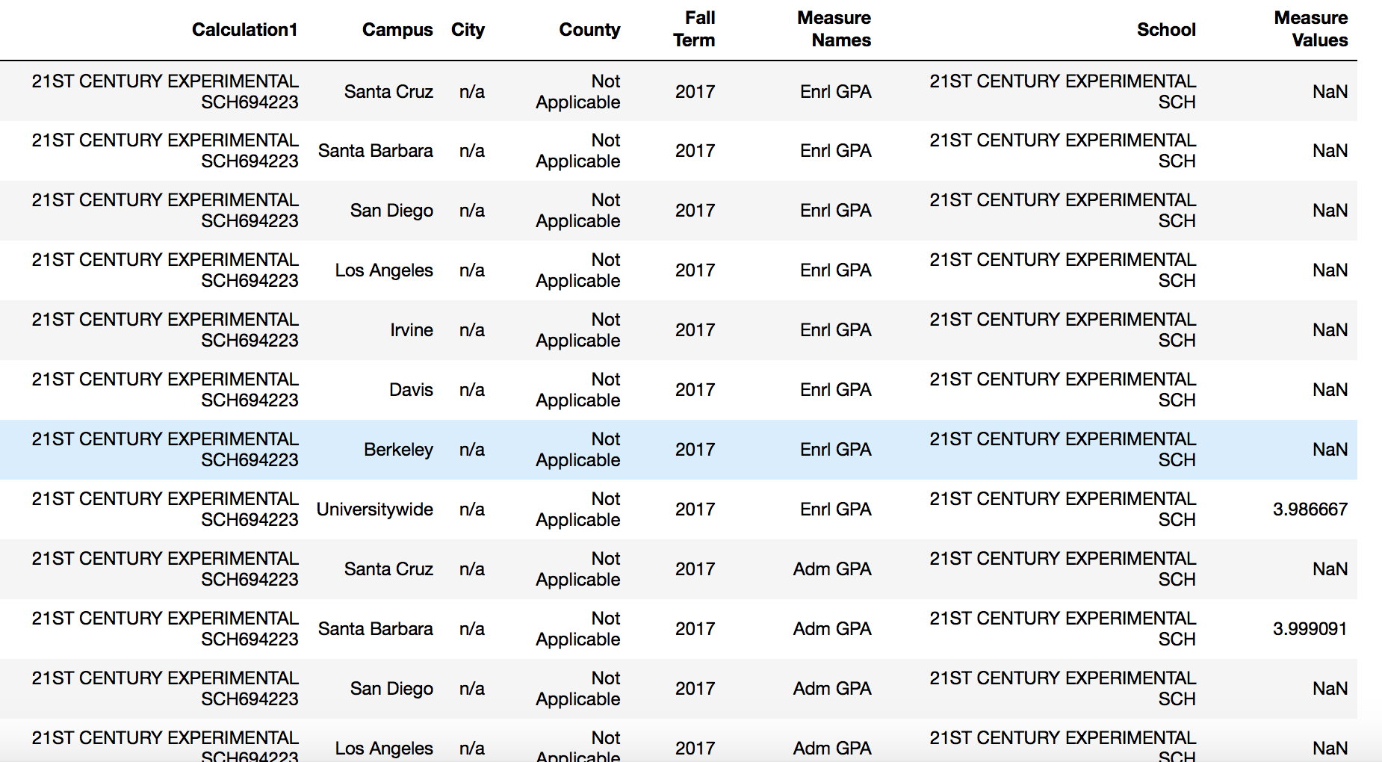
Data Cleaning

Slide 6
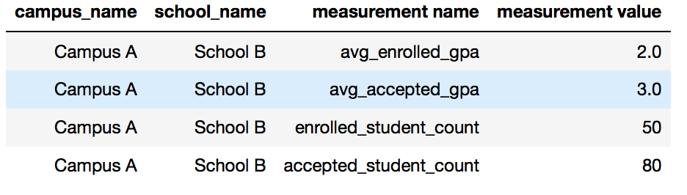

Data Cleaning

Slide 7
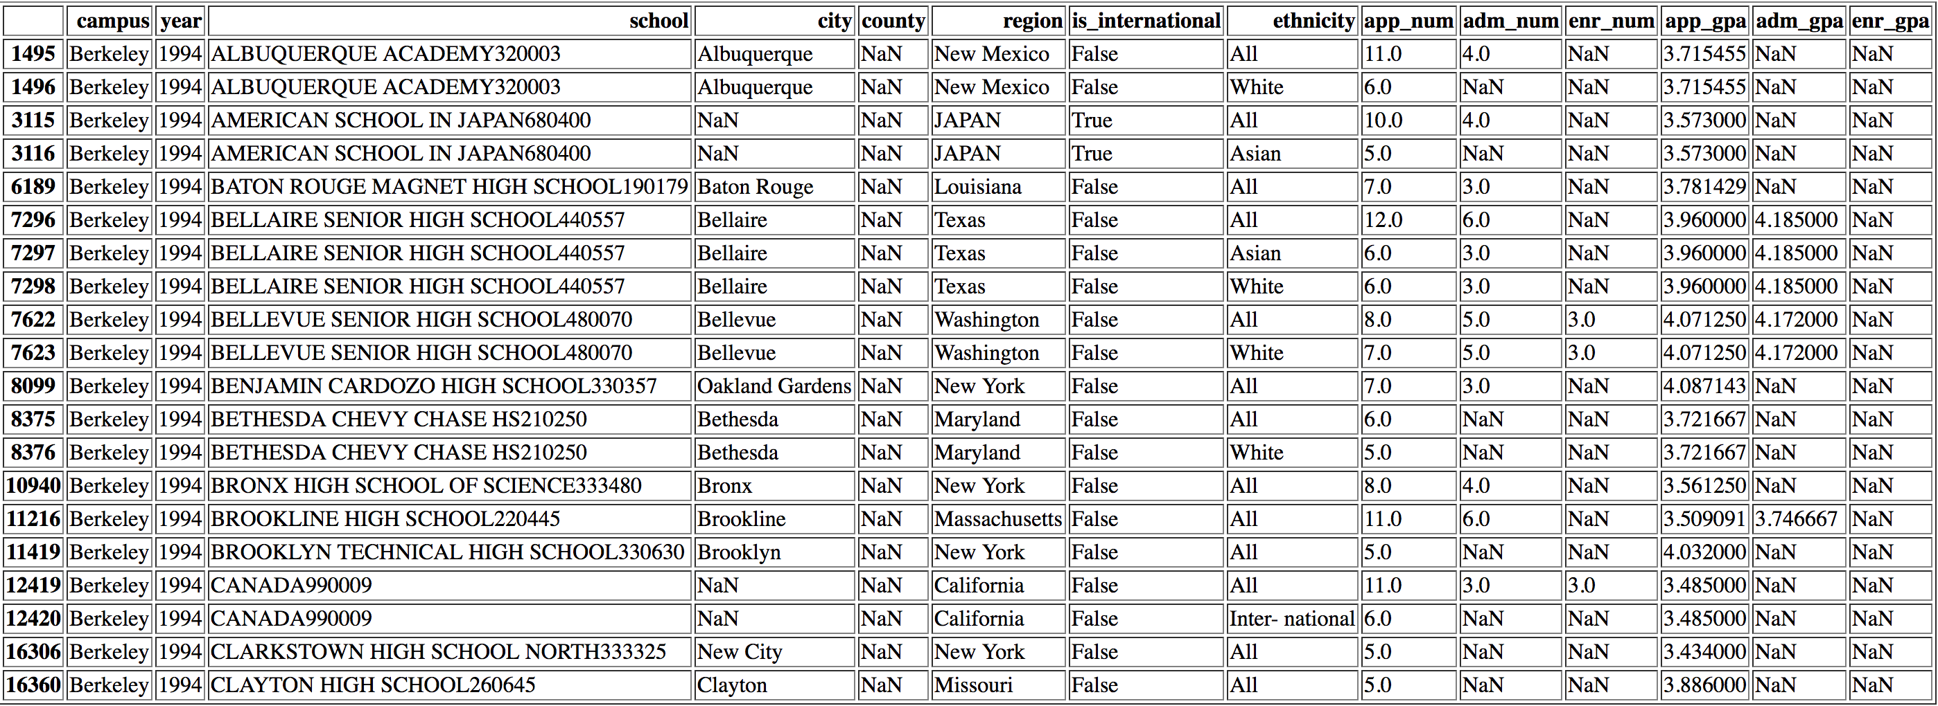
Data Cleaning: Result
One row per ethnicity
UC withholds counts when less than 3 datapoints, GPA when less than 3 datapoints
We had to do some manual NaN conversions and filtering

Slide 8
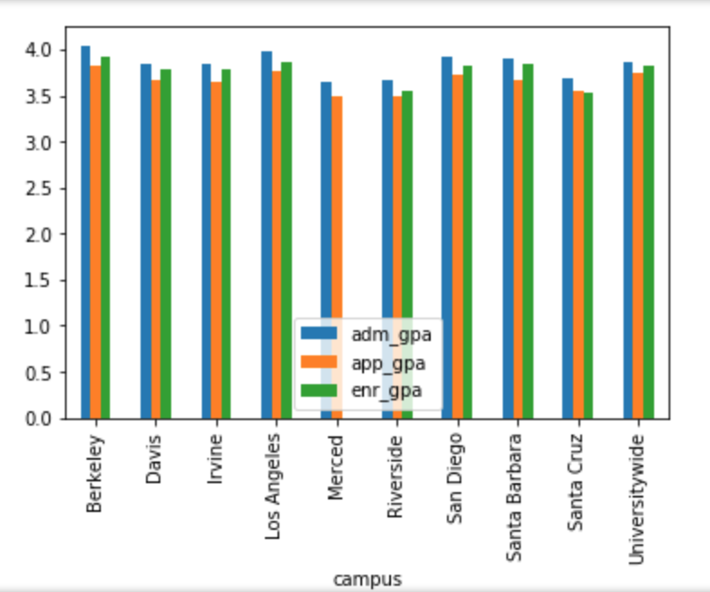
Visualization
Bar Chart For Average GPAs

Slide 9
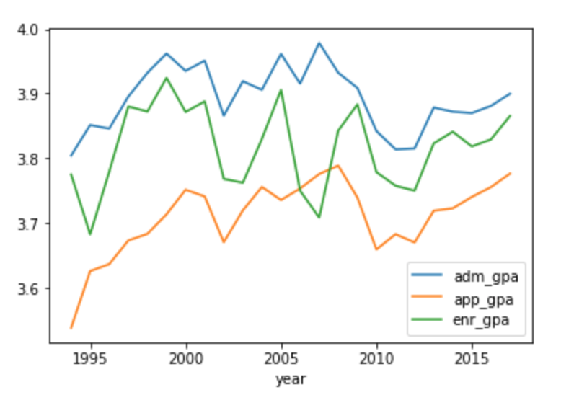
Visualization
GPA Inflation over years

Slide 10
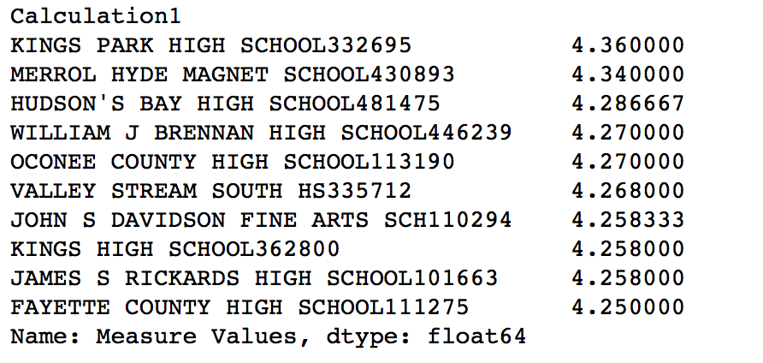
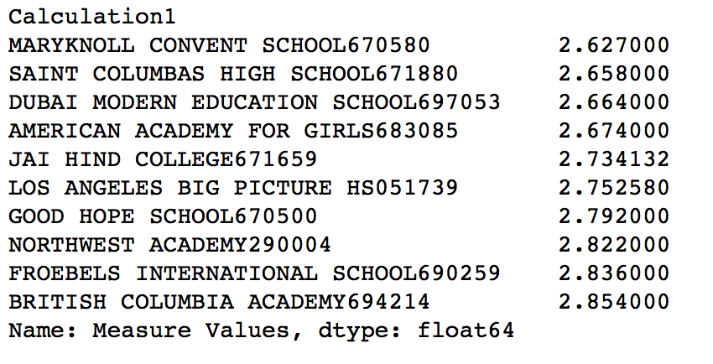
Exploration
Schools with the highest GPAs
Schools with the lowest GPAs

Slide 11
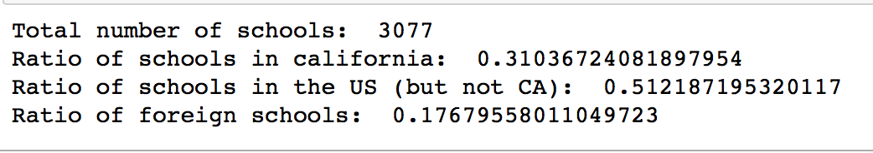
Exploration
Summary

Slide 12
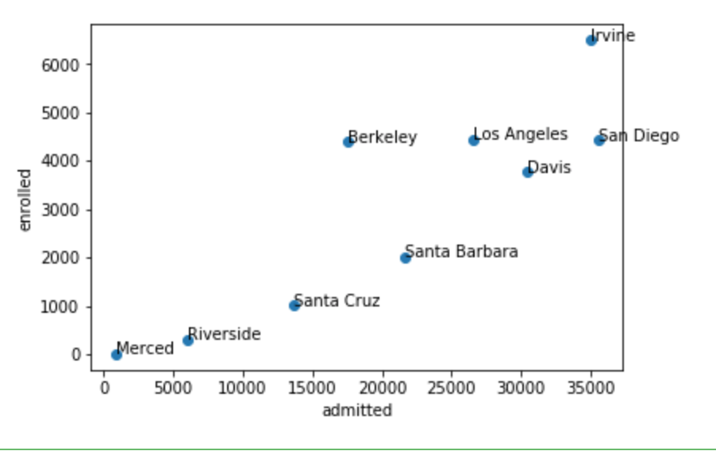
Visualization
Admitted vs Enrolled (measure of desirability)

Slide 13
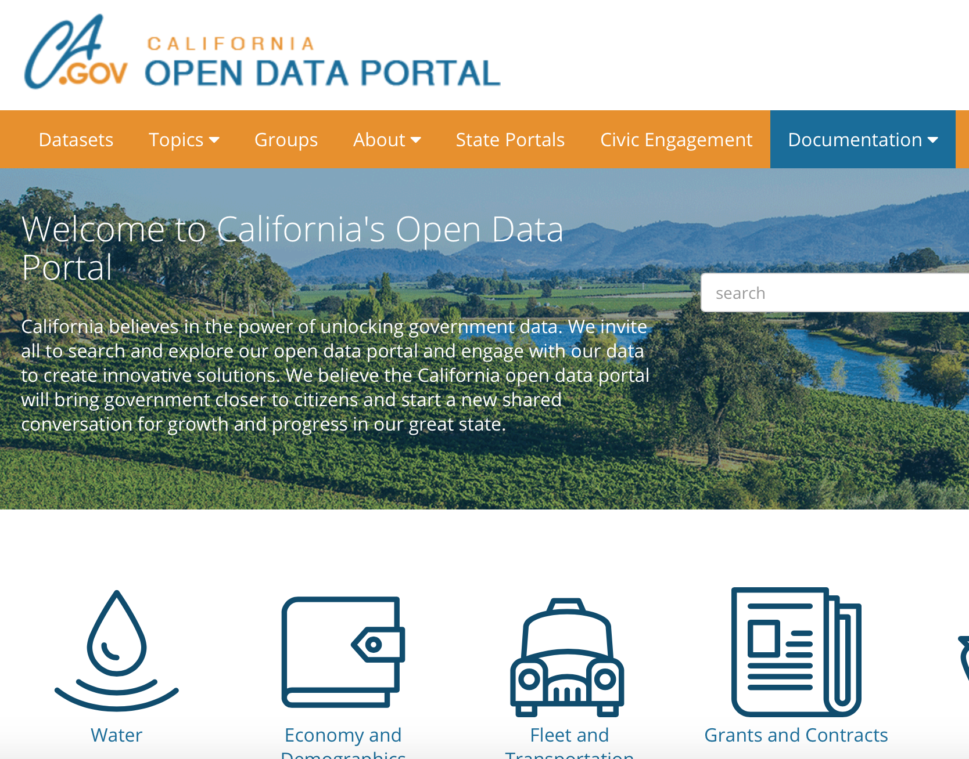
Future Plans
The predictive power of the existing data sets might not be enough.
Demographic Information about the surveyed high schools.
Developing a ML model for predicting student yield.

